Slide 1
ESG DD Assessment
Sample Loop

Slide 2

Industry Maturity | Target industry’s relative ESG maturity
overall_0_132205576424240331 columns_1_132188157256798213 81_0_132188151966186840 174_0_132193379297241169 180_0_132193379297241169 183_0_132193379297241169 184_0_132193379297241169 190_0_132193436935969509 13_1_132397429674111526 177_0_132204661290867481 185_0_132204661290867481 195_0_132204661290867481 198_0_132204661290867481 33_0_132205576428808111 226_0_132206362491722326 35_0_132206362580556458 38_0_132206362609266454 41_1_132206363108792623 70_1_132206466957359112 7_1_132397429556617192 10_1_132206471072556748 16_1_132404856140016161 21_1_132213181945901211 171_1_132272270019553488
materiality
Industry maturity
Illustrative
ESG rating distribution by industry
Utilities
(47.7)
Paper
products
(50.6)
Chemicals
(45.4)
IT hardware
(45.1)
Automotive
(44.1)
Transportation
(44.0)
Metals and Mining
(43.2)
Containers & Packaging (42.6)
Oil and Gas
(41.8)
Cloud & IT Services (41.5)
Healthcare
(39.2)
Financial Technology & Infrastructure (38.9)
Environmental, social and corporate governance rating (Refinitiv ESG Scores)
Note: The Industry level ESG score is calculated based on an average of all companies part of the selected industry sector. All overall company level ESG scores are added together then divided by the number of companies in the chosen sector that have an ESG score >0; Source: Refinitiv (2022)

Slide 3
Materiality | Summary of key ESG issues for the industry
materiality
Key issues
Preliminary
E
High
Medium
Low
GHG emissions
Water stewardship
Material use,
waste & circularity
Hazardous substances
Air
quality
Land and ocean use
Biodiversity & ecological welfare
Reducing & offsetting GHG emissions contributing to climate change
Sensible water use, water quality, and watershed management
Responsible sourcing and use of resources, incl. product, packaging, and food lifecycles (reduce, reuse, recycle)
Sensitively using and treating toxic products and waste, incl. chemical and technology pollutants
Lowering pollutants impacting air quality and atmospheric integrity
Ensuring long-term sustainable land and ocean use, incl. land/ ocean change (e.g., deforestation), sound utilization practices
Protecting and enhancing natural ecosystems and living organisms; upholding animal welfare
Environment
Living within our planetary boundaries
S
Medium
High
High
Human
rights
Labor
practices
Diversity, equity & inclusion
Health & wellness
Customer safety and access
Cyber security & digital privacy
Community partnership
Upholding the corporate responsibility to respect universal rights (e.g., life, liberty, freedom of expression, no forced/child labor)
Decent and safe work, incl. equitable pay / benefits, upskilling / development, and hiring practices
Practices and culture promoting diversity, equity, accessibility, and inclusion, inside company and beyond
Products, services, and technologies that enhance customer well-being
Safe and accessible offerings incl. safe formulations, clear labeling and non-abusive practices in marketing, access, and pricing
Secure technology systems, infrastructure, and data practices; duty of care to customer privacy; responsiveness to law enforcement
Aware and/or engaged members of the communities and broader society
Social
Committing to equitable outcomes
G
Low
Medium
Governance foundation
Business
ethics
Transparency & risk management
Third-party relationships
Tax practices
Indirect economic impacts
National and intl. policy
Governance
Norms and practices related to good governance, e.g., ownership & control, board diversity, pay, accountability
Sound decision-making, ethical conduct; no anti-competitive practices, bribery, or corruption
Accurate accounting; appropriate risk disclosure and management; ESG transparency
Clear practices embedded in sourcing activities and investment and partnership decisions
Fair tax payment and practice
Sensitivity to indirect impacts on external populations of firm’s economic activity
Appropriately navigating complex domestic and international issues, incl. policy and lobbying stances
Demonstrating responsible conduct

Slide 4



Materiality – external rating lens | Material issues for Target industry based on external rating agencies
materiality
External rating lens
Stakeholder materiality: Impact of sustainability, a “force for good”/push beyond compliance
Financial materiality: Financial impact assessment of ESG risks (company / investor focus)
Low
Medium
High
Not likely a material issue
Likely a material issue
Not mentioned
0-20% weight
>20% weight
Key risks | Score² | Score³
Energy Consumption & GHGs
Water
Biodiversity
Local & Accidental pollution
Materials, Chemicals & Waste
Product Use
Product End-of-Life
Customer Health & Safety
Environ. Services & Advocacy
Employee health & safety
Working Conditions
Social dialogue
Career Management & Training
Child Labor & Human Trafficking
Diversity & Discrimination
Ext. Stakeholder Human Rights
Corruption
Anticompetitive Practices
Responsible Information Mgmt.
Supplier Environ. Practices
Supplier Social Practices
General Issue Category | Score⁴
GHG Emissions
Air Quality
Energy Management
Water & Wastewater Mgmt.
Waste & Hazardous Material Mgmt.
Ecological Impacts
Product Design & Lifecycle Mgmt.
Business Model Resilience
Supply Chain Management
Materials Sourcing & Efficiency
Physical Impacts of Climate Change
Human Rights & Comm. Relations
Customer Privacy
Data Security
Access & Affordability
Product Quality & Safety
Customer Welfare
Selling Practices & Product Labeling
Labor Practices
Employee Health & Safety
Employee Engagement, D&I
Business Ethics
Competitive Behavior
Mgmt. of Legal & Regulatory Env.
Critical Incident Risk Management
Systemic Risk Management
Key issues | Weight⁵
Carbon Emissions | 5%
Financing Environmental Impact
Water Stress
Opportunities in Clean Tech | 2.3%
Product Carbon Footprint
Packaging Material & Waste
Raw Material Sourcing
Toxic Emissions & Waste
Chemical Safety
Consumer Financial Protection | 29%
Human Capital Development
Privacy & Data Security | 22.5%
Access to Finance | 0.3%
Responsible Investment
Community Relations
Product Safety & Quality
Labor Management
Supply Chain Labor Standards
Health & Safety
Access to Communications
Access to Health Care
Controversial Sourcing
Governance | 40.8%
Ownership & Control
Board
Pay
Accounting
Business Ethics
Tax Transparency
E
Env.
E
Bus. model& innov.
S
S
Social capital
Human capital
G (E¹)
G
Leader-ship gover.
G (S¹)
Note: EcoVadis helps companies through an assessment based on self-reported questionnaire (incl. supporting information) analyzed by EcoVadis experts; SASB (Sustainability Accounting Standards Board) is a standard framework covering industry-specific financially material ESG issues identified by SASB, with goal of to help businesses report on sustainability to their investors. MSCI provides an assessment based on in-house research gathering publicly available information (specialized datasets, company disclosures and media sources) which is mapped against key issues per industry based on MSCI research; (1) Governance: Ethics, Suppliers respectively; (2) : Data presented for “Computer Programming, Consultancy and Related Activities”; (3) Data presented for “Data processing, hosting and related activities; web portals” (4) Data presented for “Software & IT Services”; (5) Data presented for “Internet Services & Infrastructure” | Source: EcoVadis, SASB, MSCI

Slide 5






Materiality – peer lens | Material issues for Target industry based on peer materiality matrices
Materiality
Peer lens
Key ESG
risk
Issue identified (critical)
Issue identified (not critical)
Issue not identified
Not exhaustive
 |  | Target | Peer 1 | Peer 2 | Peer 3 | Peer 4 | Peer 5
 | GHG emissions
 | Water stewardship
 | Material use, waste & circularity
 | Hazardous substances
 | Human rights
 | Labor Practices
 | Diversity, equity & inclusion
 | Health & wellness
 | Cyber security & digital privacy
 | Business ethics
 | Third-party relationships
 | National and International Policy
E
S
G
Note: Material issues identified based on materiality matrices of the peers, where the peers identify different issues and specify criticality of each issue
Source: Company Reports; Company websites

Slide 6
Materiality – Pressure from Stakeholders | Pressure from Government, Customers, Industry Bodies and Peers for key ESG themes
Materiality
Not exhaustive
 | Issue | Material axes | Pressure from | Evidence
 | Diversity, equity & inclusion | Equal opportunities for women, racial minorities, veterans, and LGBTQ+ groups Closing the gender pay gap | Government Customers Peers | The European Commission introduced a draft directive to make detailed gender pay gap reporting a legal requirement, which is expected to pass into EU law by 2024; UK, Belgium, and Austria have mandated gender pay gap reporting While the US enforces the Equal Pay Act which enables fair wages, pay transparency and pay gap reporting have only been enforced at the local level in select states and cities Customers (e.g., Customer 1, Customer 3) have set guidelines for vendors to report D&I progress, and prohibit any discrimination Peers have taken steps such as participation in Corporate Equality Index, Diversity Charter, female education initiatives etc. to promote gender equity and inclusion of racial minorities, veterans, people with disabilities, and LGBTQ+ groups
 | Cyber security & digital privacy | Confidential and personal information protection Compliance with local and international data protection regulations Cybersecurity certifications and audits | Government Customers Peers Standard-setting bodies | EU Regulations such as GDPR², UK-GDPR², BDSG³, etc. provide strict protocols regarding data handling, risks, individuals’ rights, transparency, training, breach protocols, etc. US regulations such as HIPAA⁴, Gramm-Leach-Bliley Act, Fair Credit Reporting Act, etc. audit and enforce data privacy and access in the country; state-wise regulations (e.g., CCPA⁵, New York SHIELD⁶ Act, etc.) also enforce variations of national data protection guidelines Customers have strict guidelines on data handling protocols for proprietary, confidential, and commercial information Peers have undertaken several steps to be compliant with international standards (e.g., ISO/IEC 27001) and implemented security measures to handle data and information systems with strict protocols Compliance with international standards like ISO/IEC 27001 provide formal recognition of cybersecurity and data privacy efforts
 | Business ethics | Sound decision-making and ethical conduct Fait competitive practices Prohibition of bribery and corruption | Customers Peers | Customers require vendors to prohibit all forms of corruption, avoid conflicts of interest, have a channel available for reporting serious concerns in a confidential manner, and comply with applicable laws Peers have an established a code of conduct and a whistleblower system to report any violations or unethical practices
 | National and intl. policy | Relationships with governments Lobbying to receive regulatory approvals in multiple countries | Peers Tech lobbies | Large technology companies with Irish operations (e.g., Amazon and Google), and other heavy power users lobbied with the Irish government that was aiming to curtail new data centers owing to concerns about constraints on the electricity network Amazon and other technology companies have lobbied with the US government to promote cloud services and expand businesses in new areas
Note: (1) Distributed denial of service; (2) General Data Protection Regulation; (3) German Federal Data Protection Act (Bundesdatenschutzgesetz); (4) Health Insurance Portability and Accountability Act; (5) California Consumer Privacy Act; (6) Stop Hacks and Improve Electronic Data Security | Source: Lit. search, Bain analysis

Slide 7
Materiality – customer lens | Pressure from Target’s customers on supplier guidelines across key ESG themes
materiality
Customer lens
Not exhaustive
Detailed customer priorities across ESG themes available in the appendix
Customer 1
Customer 2
Customer 3
Customer 4
Requires suppliers to comply with EDF’s global CSR agreement that encompasses ESG issues
Requires suppliers to make necessary ESG disclosures such as streamlined energy and carbon reporting regulations
Suppliers are required to abolish any form of forced or child labor, and pay fair wages according to applicable laws
Encourages suppliers to have robust and clear data to measure DE&I¹ progress and achievements
Requires compliance with privacy and information security laws, and provide support during audits
Requires suppliers to sign the Supply Chain Charter and evaluates performance through EcoVadis assessments
100% of suppliers/vendors were assessed by EcoVadis in 2021
Suppliers are expected to contribute to its objectives of building a low-carbon economy
Requires suppliers to provide employees with a healthy working environment with appropriate EH&S² measures
Suppliers are required to respect and promote the principles of DE&I¹
Requires compliance with all laws and regulations and company guidelines regarding the protection of personal data including identification information and commercial data
Requires suppliers to undergo a mandatory code of conduct training before being onboarded
Published a new Sustainable Procurement Charter aligned with ISO20400 (international standard for sustainable procurement)
Suppliers are encouraged to use processes and materials that support sustainability of the environment throughout the supply chain
Suppliers must provide a clean, safe and healthy work environment for all employees
Suppliers are expected to ensure that employment is based on ability and not on discriminatory beliefs
Suppliers are required to ensure that all personal information and data systems are controlled in compliance with applicable laws and regulations
Suppliers are encouraged to sign the code of conduct that is based on the ILO Convention of Core Labour Standards
93% of suppliers/vendors by purchasing volume signed the code in 2021
EcoVadis will be used as a CSR risk management assessment tool starting from 2022
Social and labor standards of suppliers are monitored for compliance through audits, inspections, and/or sustainability reports
Plans to refresh the supplier code of conduct based on Germany’s new Supply Chain Act (which will come into force in 2023), which will require mandatory supplier due diligence on environmental risk areas (waste management, water consumption, etc.) and human rights (labor laws, health and safety, etc.)
Non-compliance with customer’s supplier guidelines may lead to jeopardized business relationships and contract terminations
Note: (1) Diversity, equity and inclusion; (2) Employee health and safety
Source: Company websites, company supplier code of conduct, sustainability reports

Slide 8




Materiality – regulatory lens | Outline of key regulations driving adoption of ESG initiatives in Target’s industry
overall_1_131631021853224434 columns_1_131631021853224434
Materiality
Regulation lens
Not Exhaustive
Pre-2000
The Environment Protection Act 1990
Main legislation governing proper disposal of clinical waste
States that all producers of waste have a ‘Duty of Care’ to ensure the correct management of waste, including documenting the transfer of waste and ensuring its proper handling
Also requires compliance with The Waste Hierarchy¹
2018: General Data Protection Regulation (GDPR)
Health and social care organizations are subject to stricter GDPR guidelines to ensure personal data protection
GDPR defines 3 types of ‘health data’ that require special protection: data concerning health, genetic data, and biometric data
Such data is classified as sensitive and is generally prohibited from any kind of processing unless explicit consent is given
Future regulations
2021: Govt.’s acceptance of MediShield Life Council’s recommendations which:
Created a list of clinically proven and cost-effective outpatient cancer drug treatments
Allowed cancer drug treatments to be claimable under MediShield Life⁴
Set more granular claim limits to provide better coverage based on the cost of each treatment
2016: Ethical Code and Ethical Guidelines
SMC² Ethical Code and Ethical Guidelines outline the standards of practice and behavior of doctors
2021-2027: EU strategic framework on H&S⁵ at work
Vision Zero approach to workplace fatalities
Framework to encourage avoidance of gender bias when assessing and prioritizing risks for action
2007: Health Products Act
Regulates the manufacture, import, supply, presentation and advertisement of health products and of active ingredients used in the manufacture of health products to ensure safety of patients
2017: EU Action Plan 2017-19
Adopted to address gender pay gap
Agreed on implementation of pay transparency and audits to facilitate collection of sector specific data and develop appropriate action plans
2019: Voluntary Scheme for Branded Medicines Pricing and Access
Two-fold scheme which sets out a range of measures to improve access to medicines and create an affordability mechanism
Caps overall growth on NHS³-branded medicines sales at 2% per year
2021-25: Pricing mechanism reforms
China’s reform of public healthcare service pricing mechanisms includes a pilot program which aims to ensure proper compensation for service providers and affordable costs for consumers
Plans to start the pilot programme in five cities before national launch by 2025
Note: (1) A set of priorities for the efficient use of resources which underpins the objectives of the Waste Avoidance and Resource Recovery Act 2001; (2) Singapore Medical Council; (3) National Health Service; (4) Public statutory insurance system of Singapore; (5) Health & Safety | Source: Lit. search; Bain analysis

Slide 9
ESG Reporting | Target’s performance on key ESG themes in comparison to its relevant peers
Peer comparison
ESG Reporting
Covered | Limited coverage | No evidence | Shortlisted for benchmarking
Key Metric | Target | Peer 1 | Peer 2 | Peer 3 | Peer 4 | Peer 5 | Peer 6 | Peer 7 | Peer 8
ESG champion/ team in the public domain
ESG information on website
Published ESG/ sustainability report
ESG information in annual/ strategic report
Published CDP Climate Report
Rated by EcoVadis
Defined ESG targets/ KPIs
Climate Neutral Data Center Pact signatory ²
ESG team
Communication
Other metrics
Source: Company websites; Annual and Sustainability reports; Sustainalytics; EcoVadis; Lit. search

Slide 10






ESG ratings | Ranking of Target’s ESG performance by leading rating agencies
Peer comparison
ESG Ratings
Not exhaustive
Core cloud services competitors
Broader IT service players
 | Ranking | Target | Peer 1 | Peer 2 | Peer 3 | Peer 4 | Peer 5 | Peer 6
 | Severe to negligible ESG risk | Medium | Medium | Medium | N/A | Medium | Low | Low
 | CCC to AAA ESG rating | N/A | A | BBB | N/A | N/A | AA | AA
 | Out of 100 | N/A | N/A | 36 | N/A | N/A | 83 | 58
Environment |  | N/A | N/A | 40 | N/A | N/A | 98 | 62
Social |  | N/A | N/A | 31 | N/A | N/A | 73 | 62
Governance |  | N/A | N/A | 38 | N/A | N/A | 79 | 53
 | Out of 100 | N/A | 23 | 43 | N/A | 35 | 76 | 71
Environment |  | N/A | 10 | 32 | N/A | 20 | 75 | 77
Social |  | N/A | 49 | 37 | N/A | 25 | 88 | 91
Governance |  | N/A | 4 | 64 | N/A | 48 | 66 | 52
 | Bronze (top 50%) to Platinum (top 1%) | N/A | N/A | N/A | Silver (2021) | N/A | Platinum (2021) | Gold (2021)
Climate change | D- to A | N/A | C | C | N/A | N/A | A | C
Mainstream generalist ESG
data providers
Carbon data
providers
Performance comparison:
Leader
Strong
Medium
Laggard
N/A
Source: MSCI; Refinitiv; Sustainalytics; EcoVadis; CDP Climate Change 2021; Bain analysis

Slide 11
ESG initiatives | Initiatives in place by Target and peers across key ESG themes (1/2)
Peer comparison
Initiatives
Best in class initiatives
Not exhaustive
Deep-dive on initiatives across the ESG themes available in the appendix
 |  |  |  | Target | Peer 1 | Peer 2 | Peer 3 | Peer 4
GHG Emissions |  |  |  | PPA (Power Purchase Agreements) for ~78% renewable energy; carbon capture program for Scope 1 & 2 by 2025 and Scope 3 by 2030 | Developed a ‘Carbon Reduction Plan’; deployed smart building automation systems in data centers and purchases 100% REGO¹ backed energy | Its US data center operates completely on wind power while in UK and Germany, 100% of electricity comes from renewable sources | All data centers run on 100% renewable energy; 20% power from PPA by 2035; reduced storage power consumption by 20% through densification of storage servers | Reduced energy consumption by 50% by installing a heat removal system; purchases REGO¹ certified renewable electricity
Water Stewardship |  |  |  | Measures Water Usage Effectiveness (WUE) for datacenter operations (0.17-0.20 L/kWh in 2021) | Utilizes condensate from HVAC units for landscaping and cooling towers; uses stored rainwater for flushing systems | No information available | Measures WUE for datacenter operations (0-0.15 L/kWh in 2020); installed an adiabatic cooling system consuming minimal water | No information available
Waste Management |  |  |  | Recycles components to expand their overall lifecycle with ~20% components being in their 2nd or 3rd lifecycle; servers are fully recyclable, with components easy to reuse, recycle and repair | Implemented battery recycling programs; maintains 100% equipment packaging waste recycling and zero landfill sites | Recycles and disposes of servers that are at the end of their service lives | Increased avg. lifespan of equipment through preventive measures (~80% of servers have >7 years of stock age); has block storage offering built out of recycled materials | Reuses and recycles materials and disposes of waste in an environmentally responsible way
Labor Practices |  |  |  | Offers childcare services, 24x7 medical center and an Employee Assistant Program (EAP); implements working time adjustments for disabled and senior employees | Has several resource groups for employees which support working parents, supporting mental and physical wellness; provides trainings and learning opportunities via its ‘52+ Learning Hours’ program | ABC training series for new in-house staff; operates a central training portal to provide training and e-learning opportunities | Partnered with ABC, a networking platform for women; has a progressive remote working policy which takes stock of impact of remote working on mental health | Enhanced its employee benefits package to include paternity, adoption leave; revamped its brand values with “People First” at the core
Note: (1) Renewable Energy Guarantees Origin
Source: Company websites and reports, Lit search

Slide 12
ESG initiatives | Initiatives in place by Target and peers across key ESG themes (1/2)
Peer comparison
Initiatives
Best in class initiatives
Not exhaustive
Deep-dive on initiatives across the ESG themes available in the appendix
 |  |  |  | Target | Peer 1 | Peer 2 | Peer 3 | Peer 4
Diversity & inclusion |  |  |  | A high proportion of women representation in leadership positions (~35%); has an annual budget to provide customized workstations for differently-abled employees | Achieved 4th consecutive perfect score (100) on the Human Rights Campaign’s Corporate Equality Index and named the Best Place to Work for LGBTQ Equality for the 3rd consecutive year | Signatory of the Diversity Charter¹⁰, committing to creating a non-discriminatory working environment; organized a three-day conference “Diversity Days” and launched an LGBTIQ+ initiative, “queer.united” | Partnered with ABC to provide opportunities to disadvantaged women in the digital tech space; host workshops, as part of France Digitale's network for women and minorities | Partnered with Scotland's Empowering Women to Lead Digital Transformation leadership program
Cyber security & data privacy |  |  |  | Granted the SecNumCloud label by the (ANSSI) in 2021 (data security standard for cloud service providers); Compliant with ISO27001¹, ISO27017², PCI DSS³, HDS⁴, etc. | Offers security solutions such as application security (WAF⁵, DDoS⁶ protection), data protection (access policy, encryption); Accredited with ISO 27001/2¹ | To improve security measures, it provides global distributed DDoS shield⁶, Transport Layer Security (TLS)^{7;} certified in accordance with ISO27001¹ | Compliant with ISO27001¹, HDS⁴, SWIPO^{8;} have alert systems that are activated in case of DDoS⁶ attacks, for all impacted servers to ensure data protection | A new security partnership with cyber security specialists ‘e2e-assure’ to deliver proactive 24/7 security; Accredited with ISO 27001¹
Business Ethics |  |  |  | Whistleblower policy allows stakeholders to report any illegal and/or unethical behavior and has a Code of Ethics, Supplier Code of Conduct, Anti-Corruption Policy | Maintains a global whistleblower platform, ‘Speak Up’, allowing employees and external stakeholders to report violations; deals only with suppliers who uphold the same ESG standards | Introduced a new electronic whistleblower system in 2021 to report any violations or unethical practices | Implemented an internal Code of Ethics for all employees in direct contact with suppliers and third parties | Adopted the Quoted Companies Alliance (QCA)⁹ Corporate Governance Code, providing an outcome-oriented governance framework to support its business
National & intl. policies |  |  |  | Fully compliant data centers located across Australia, Canada, France, Germany, Poland, Singapore, United Kingdom and United States serving 183 countries | Fully compliant data centers located across Australia, China, Germany, Hong Kong, Netherlands, United Kingdom and United States serving 120 countries | Fully compliant data centers located across Germany, Spain, United Kingdom and United States | Fully compliant data centers located across France, Netherlands and Poland serving 160 countries | Fully compliant data centers located across the United Kingdom
Note: (1) Standard on managing information security; (2) Security standard developed for cloud service providers; (3) Payment Card Industry Data Security Standard; (4) Implementation of measures keeping personal health data secure, confidential and accessible; (5) Web application firewall; (6) Anti - Distributed denial of service protects the cloud network from potential attackers; (7) Provides authentication, privacy and data integrity between applications; (8) A multi-stakeholder group facilitated by the European Commission to develop Codes of Conduct for the proper application of the EU Free Flow of Non-Personal Data Regulation / Article 6 "Porting of Data“; (9 A membership organization that enables principles-based, corporate governance code for small and mid-sized quoted companies in the UK; (10) A corporate initiative to promote diversity in companies and institutions | Source: Company websites and reports, Lit search

Slide 13
ESG Targets | Future targets set by peers and Target across key ESG themes
Peer comparison
Targets
Best in class
Second best in class
Not exhaustive
 | KPI | Current | Target | Current | Target | Current | Target | Current | Target | Current | Target
 | Scope 1 & 2 GHG emissions reduction^ | N/A | Net zero (by 2030) | N/A | Net-zero (by 2045) | N/A | N/A | -1.5% (2020 vs. 2019) | N/A | 3.6% (2021 vs. 2020) | Net-zero (by 2050)
 | Scope 3 GHG emissions reduction^ | N/A |  | N/A |  | N/A | N/A | -69% (2020 vs. 2019) | N/A | 86% (2021 vs. 2020)
 | Share of renewable electricity (%) | 78% (2021) | 100% (by 2025) | 100% (2021) | N/A | 100% (2022) | N/A | 100% (2020) | N/A | 100% (2022) | N/A
 | Water Usage Effectiveness | 0.17-0.2 (2021) | N/A | N/A | N/A | N/A | N/A | 0-0.15 (2020) | N/A | N/A | N/A
 | Power Usage Effectiveness | 1.1-1.3 (2022) | 1.3 (2025,2030) ² | 1.15 (2015)³ | N/A | N/A | N/A | 1.4 (2020) | <1.15, 1.3⁴ | N/A | N/A
 | Gender pay gap (median / average) | N/A | N/A | 18% / 15% (2021)⁵ | N/A | N/A | N/A | N/A | 0% (2022) | 7% / 15% (2020) | N/A
 | % of female employees | N/A | N/A | N/A | N/A | 32% (2021) | N/A | 19% (2020) | N/A | N/A | N/A
 | Female leadership representation (%) | 33% (2022) | N/A | 22% (2022) | N/A | 18% (2021) | N/A | 38% (2020) | N/A | 27% (2022) | N/A
 | Female representation on the board | 38% (2022) | N/A | 11% (2022) | N/A | 25% (2022) | N/A | N/A | N/A | 14% (2022) | N/A
 | ESG champion / Sustainability committee |  |  |  |  |  |  |  |  | N/A
 | Ethics helpline / whistleblower policy |  |  |  |  |  |  | N/A
E
S
G
Note: (^) Negative numbers indicate an increase
Source: Company websites and reports, BoardEx

Slide 14
ESG Reporting | Target performance on Scope 1 and 2 emissions intensity in comparison to peers
overall_0_132484222119873488 columns_1_132470061251238000 26_1_132475883887079101 20_0_132483674567976131 25_1_132483674567976131 27_1_132484221297531481 28_1_132484221297531481 41_1_132484221797136317 6_1_132545101530330726
Peer comparison
GHG emissions
preliminary
Scope 2 emissions form the largest part of GHG emissions driven by high electricity consumption by datacenters
Emissions from generators and office air conditioning comprise scope 1 emissions while electricity consumption drives scope 2 emissions
Scope 3 emissions have not been shown since they were not comparable across the peer set (owing to differences in scope of measurement and reporting)
Legend
Scope 1
Scope 2#
Scope 2 emissions include emissions from purchased electricity
Note: (#) Location-based figures used, where available; (*) Power usage effectiveness – indicator for measuring the energy efficiency of a datacenter; lower score signifies higher energy efficiency
Source: Company reports

Slide 15
Customer lens – backup | Supplier guidelines set in place by Target’s customers across key ESG themes (1/2)
materiality
Customer lens
Not exhaustive
 | Customer 1 |  | Customer 2
 | Suppliers are required to make disclosures in relation to legislations such as streamlined energy and carbon reporting regulations Support suppliers to use less energy and switch to low-carbon energy sources |  | Suppliers must work on reducing GHG emissions, preventing pollution, and contributing to a low-carbon economy
 | Performs a supplier pre-qualification assessment to check compliance with UN regulations on labor practices (e.g., 1948 UN Universal Declaration, 1998 ILO Declaration, UNGC¹) Suppliers must avoid any form of forced or child labor, and pay fair wages according to applicable laws |  | Suppliers must provide employees with a healthy working environment and adopt appropriate EH&S³ measures for all personnel Suppliers must comply with tax and social obligations and remunerate employees in accordance with applicable laws
 | Suppliers are expected to comply with the Equality Act 2010²; recruit, develop, and promote based on professional abilities, and treat everyone fairly and with respect Suppliers must have robust and clear data to measure DE&I¹ progress, including necessary disclosures regarding payment practices, gender pay gap statistics, etc. |  | Suppliers are required to promote the principles of DE&I¹and refrain from any form of discrimination based on gender, race, disability, sexual orientation, trade union membership, etc. In the UK, initiatives are in place to open access to the group’s supply chain for SMEs, women-owned businesses, and diverse-owned businesses
 | Suppliers must demonstrate an EDFR⁴-compliant approach to handling proprietary or confidential information, comply with applicable privacy and information security laws, and provide support during audits by EDFR⁴ |  | Suppliers need to comply with all laws and regulations and company guidelines relating to the protection of personal data including identification information and commercial data
 | Suppliers must ensure that employees have a channel available for reporting serious concerns in a confidential manner independent of the normal line-management reporting structure Suppliers are expected to maintain controls to identify conflicts of interest, and ensure that the risks of such conflicts are mitigated |  | Suppliers must prohibit all forms of corruption and influence peddling, undertake to avoid conflicts of interest, and comply with applicable laws
 |  |  | Suppliers must promote a circular economy, and manage waste by reducing it to a minimum and maximizing its recycling
Note: (1) UN Global Compact; (1) Diversity, equity and inclusion; (2) UK law that protects people from discrimination
in the workplace and in wider society; (3) Employee health and safety; (4) EDF Renewables
Source: Company websites, company supplier code of conduct, sustainability reports

Slide 16
Customer lens – backup | Supplier guidelines set in place by Target’s customers across key ESG themes (1/2)
materiality
Customer lens
Not exhaustive
 | Customer 3 |  | Customer 4
 | Suppliers must comply with applicable local environmental laws and encourage the use of processes and materials that support sustainability of the environment throughout the supply chain |  | Plans to screen and report suppliers on environmental risks such as handling, collection, storage, and disposal of waste in line with Germany’s new Supply Chain Act that will come into force in January 2023
 | Suppliers must treat all workers with respect and prohibit any harsh or inhumane treatment, and mitigate any adverse human rights impacts Suppliers must provide a clean, safe and healthy work environment in compliance with mandated standards, and take precautions to protect everyone from workplace injuries and occupational disease |  | Plans to screen and report suppliers on water consumption, and any unlawful use of water resources based on Germany’s new Supply Chain Act that will come into force in January 2023
 | Suppliers are required to ensure that employment (including hiring, payment, advancement, termination and retirement) is based on ability and not on discriminatory beliefs or any other personal characteristics such as sex, race, color, political beliefs, trade union activity etc. |  | Monitors social and labor standards of suppliers through supplier-provided documentation, audits, inspections, and/or sustainability reports Plans to screen and report suppliers on human rights, OH&S¹, freedom of association, adequate wages, etc. based on Germany’s new Supply Chain Act that will come into force in January 2023
 | Suppliers must carefully handle, discuss and transmit confidential information and ensure that all personal information and data systems are controlled in compliance with applicable laws and regulations |  | Suppliers and business partners are required to comply with the information security and data protection/confidentiality conditions which are included in the supplier code of conduct
 | Suppliers should refrain from engaging in any form of commercial bribery and comply with laws of working with government officials Suppliers must avoid interactions with Serco employees that may result in a conflict of interest, and make Serco aware of any such conflicts |  | Suppliers and business partners are required to comply with the fair competition and profitable growth conditions highlighted in the supplier code of conduct
Note: (1) Occupational Health & Safety
Source: Company websites, company supplier code of conduct, sustainability reports

Slide 17
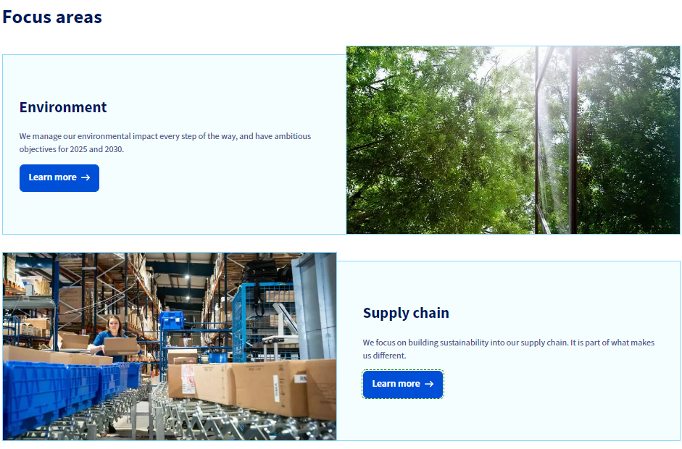
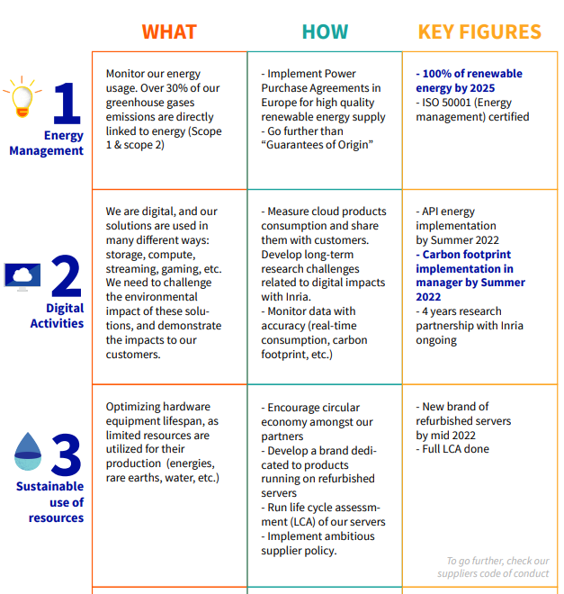
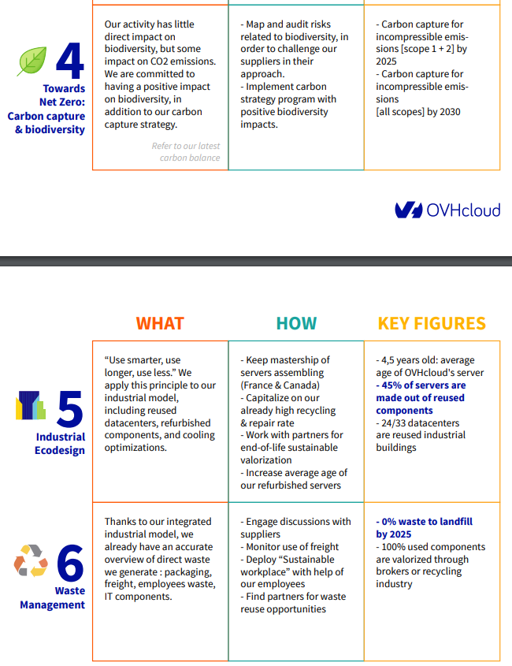
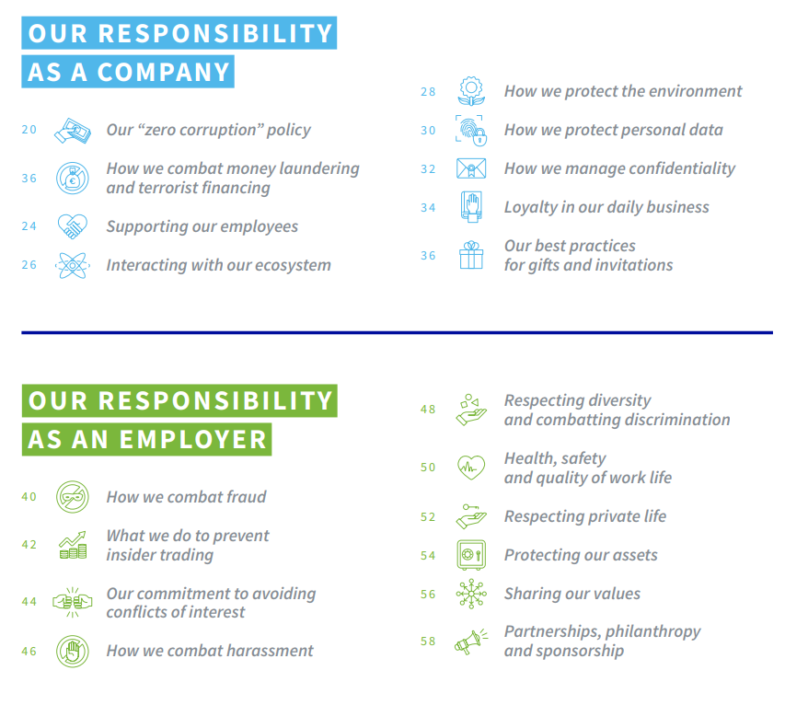
Material issues – back-up | Materiality assessment by Target and peers on key ESG focus areas (1/3)
Industry | understand what matters
Target Materiality Assessment (2022)
Target highlights emissions, water stewardship, data privacy & security and business ethics as top material topics

Slide 18
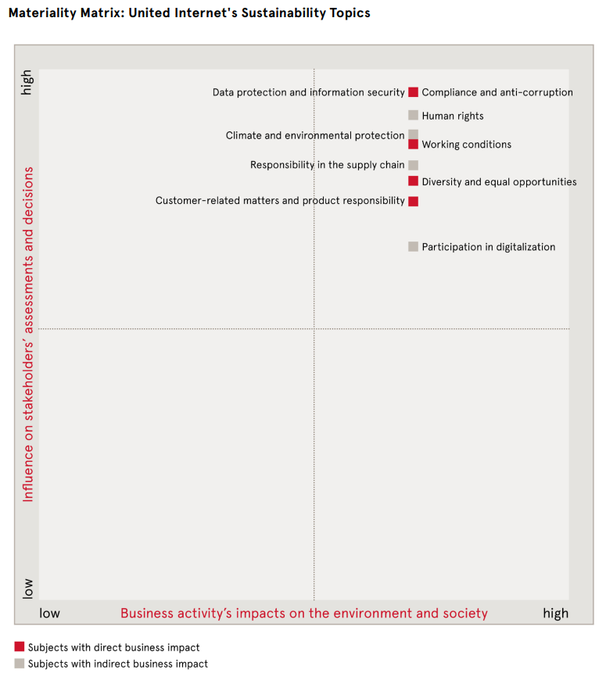
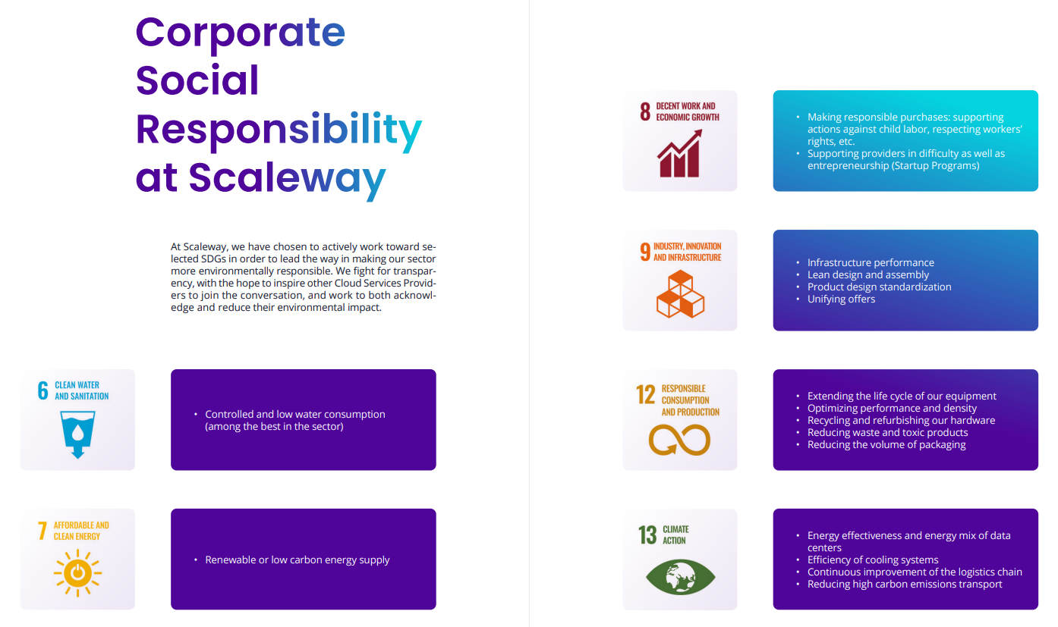
Material issues – back-up | Materiality assessment by Target and peers on key ESG focus areas (2/3)
Industry | understand what matters
Peer 1 Materiality Assessment (2021)
Peer 2 Materiality Assessment (2021)
Peer 1 highlights emissions, diversity & inclusion, data privacy & security and business ethics as top material topics
Peer 2 highlights emissions, water stewardship, data privacy & security and business ethics as top material topics

Slide 19
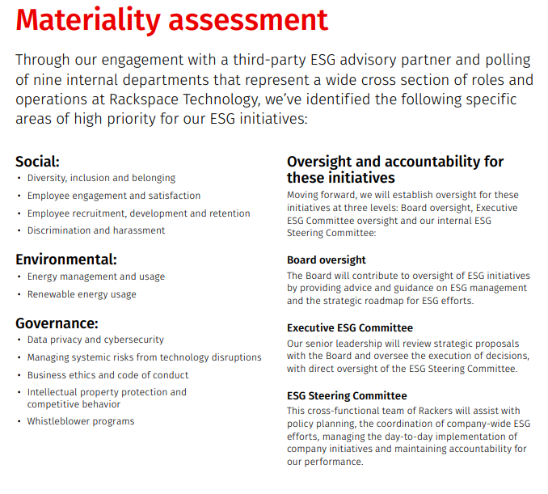
Material issues – back-up | Materiality assessment by Target and peers on key ESG focus areas (3/3)
Industry | understand what matters
Peer 3 Materiality Assessment (2021)
Peer 3 highlights emissions, diversity & inclusion, data privacy & security and business ethics as top material topics

Slide 20
ESG initiatives – backup | Target and peer initiatives across key ESG parameters (1/4)
Peer comparison
Initiatives
Lagging
At par
Leading
Not exhaustive
 |  |  |  | Target | Peer 1 | Peer 2 | Peer 3 | Peer 4
GHG emissions |  |  |  | Has an energy management system for data centers Power purchase agreements for renewable energy (78% in 2021) Planning to get ISO 50001¹ accredited Plans to launch a carbon capture program for Scope 1 & 2 by 2025 and for all 3 scopes by 2030 Part of Net Zero initiatives like Climate Neutral Data Center Pact⁴ and VMware Zero Carbon Committed⁵ initiative | Published a 'Carbon Reduction Plan' in 2022 to achieve net zero emissions by 2045 Purchases 100% REGO² backed energy for the Slough data center and London HQ Deployed smart building automation systems in several corporate offices and data centers Participates in the Climate Change Agreement (CCA)³ to reduce energy use and CO2 emissions | Uses a mix of local, renewable energy sources and carbon offset certificates to neutralize CO₂ emissions: In the US, its largest data center runs completely on wind power In the UK and Germany, 100% of the electricity for data centers comes from renewable sources Upgraded the AC system in 2020 at its largest data center in Germany, improving energy efficiency by 15% | Regularly publishes Power Usage Effectiveness (PUE) and rDCE data⁶ All data centers run on 100% renewable energy; working on sourcing 20% of power from Power Purchase Agreements (PPA) by 2035 Agreements with energy providers ensuring their renewable energy have origin guarantee certificates Banning all products that have a harmful impact on ozone Densification of storage servers enabled it to reduce storage power consumption per GB by up to 20% | Partnered with Schneider Electric to reduce carbon emissions Installed a heat removal system at the Glasgow data center, reducing energy consumption by up to 50% Received the “Best Use of Emerging Technology” honor in March 2022 for the impact it could have on carbon footprint of the data center industry Purchases REGO² certified renewable electricity across its UK data centers
Water stewardship |  |  |  | Measures Water Usage Effectiveness (WUE) for datacenter operations (0.17 - 0.20 L/kWh in 2021) | Utilizes condensate from HVAC units for landscaping and feeding water to operate cooling towers Uses stored rainwater for all flushing systems Fitted water efficient fixtures in restrooms and break areas | No information available | Incorporates Water Usage Effectiveness (WUE) as a metric to determine a data center's efficiency (0-0.15 L/kWh in 2020) Banned water cooling towers and installed an adiabatic cooling system which consumes minimal water Has closed circuits in data centers to reduce water loss (in 3 out of 4 data centers) | No information available
Note: (1) Energy management certification (2) Renewable Energy Guarantees Origin; (3) A voluntary UK scheme for energy intensive industries; (4) A pledge of industry players and trade association of cloud infrastructure services and data centres in Europe to achieve climate neutrality by 2030; (5) A collaboration with cloud providers that operate energy and carbon-efficient data centers and have commitments to using renewable energy power; (6) Real Data Center Efficiency (rDCE) is a transparent industry index to show the actual use of water & energy in data centers | Source: Company websites and reports, Lit search

Slide 21
ESG initiatives – backup | Target and peer initiatives across key ESG parameters (2/4)
Peer comparison
Initiatives
Lagging
At par
Leading
Not exhaustive
 |  |  |  | Target | Peer 1 | Peer 2 | Peer 3 | Peer 4
Waste management |  |  |  | Out of order components at the datacenters are sent to certificated partners to create new raw materials Recycles and reuses components to expand the overall lifespan (~20% components are in the second or third lifecycle) Servers are designed to be fully removable, with components chosen specifically for easy reuse, recycle and repair | Maintains 100% equipment packaging waste recycling and zero landfill sites where all waste is reused or recycled Works with suppliers to ship equipment in reusable crates Participates in recycling programs for paper, aluminum, plastic, cardboard, glass and e-waste Has implemented battery recycling programs | Ensures that servers are recycled or disposed of properly at the end of their service lives In 2020, recycled 172.39 tons of hardware | Reuses and refurbishes key components Developed a block storage offering made with recycled materials Reduces waste by purchasing the exact number of components required Participates in Digital Cleanup Day Separates and recycles five types of waste (paper/ cardboard, metal, plastic, glass and wood) Has partnerships to recycle WEEE² Increased the average lifespan of equipment through preventive measures (e.g., corrosion prevention through osmosis) | Disposes waste in an environmentally responsible way to minimize pollution Reuses and recycles materials Environmental factors are assessed when purchasing products and services
Labor practices |  |  |  | Offers childcare services in France, 24x7 medical center and an Employee Assistant Program (EAP) to improve quality of life at work and prevent psychosocial risks Developed XYZ to provide coworking and collaborative spaces, ergonomic workstations, etc. Implements working time adjustments for disabled and senior employees Has a remote work policy - 40 days per year of Home Office with flexible days | Has several resource groups for employee wellbeing such as ABC (support for working parents), XYZ (supporting mental and physical wellness), ABC (bringing together its distributed workforce) ABC three days of training for new hires on the culture and business Introduced 52+ Learning Hours – employees accrue at least 52 hours annually toward learning via trainings, solving customer problems, coaching, etc. | Signatory of the ABC Initiative – committing to provide fair conditions such as appropriate compensation and personal support XYZ training series for new in-house staff Has a central training portal (1&1 Campus) which bundles training and e-learning offerings, giving quick and easy access to development materials | Set up an internal academy to train new engineers Partnered with ABC, a networking platform for women, to connect with experts, and get access to training and learning opportunities Implemented a senior grid system that assess the seniority level and salary grid of employees to identify pay gaps Has a progressive remote policy which measures the impact of remote working on employees’ mental health | Revamped its brand values, with "People First" at the core Enhanced its employee benefits package to cover paternity, sick, adoption leave, and enhanced maternity leave to 4 months’ full pay and then 4 months half pay Rolled out a Leadership Program across the Group Introduced flexible work arrangements and changed core working hours to help families with childcare responsibilities

Slide 22
ESG initiatives – backup | Target and peer initiatives across key ESG parameters (3/4)
Peer comparison
Initiatives
Lagging
At par
Leading
Not exhaustive
 |  |  |  | Target | Peer 1 | Peer 2 | Peer 3 | Peer 4
Diversity & inclusion |  |  |  | Supports associations such as Code First Girls² to promote training and employment for women in the IT sector Has ~35% female representation in leadership roles and ~40% female representation on the Board Has an annual budget of more than €40,000 devoted to customized workstations for differently-abled employees | Achieved 4th consecutive perfect score (100) on the Human Rights Campaign’s Corporate Equality Index (2021) Named a Best Place to Work for LGBTQ Equality for the 3rd consecutive year (2021) Seeks to increase the pool of diverse suppliers (such as Women, Military/Veteran, Minority and LGBT-Owned businesses) 9 Resource Groups to further diversity & inclusion | Signatory of the Diversity Charter¹, committed to creating a non-discriminatory working environment Organized a three-day conference in 2021 with 35+ sessions on diversity Launched an LGBTIQ+ initiative, “ABC” Launched an internal podcast series featuring interviews on diversity issues, developed independently by the “Women explore” program | Partnered with XYZ to provide opportunities to disadvantaged women in the digital tech space Hosts workshops, as part of France Digitale's network for women and minorities to discuss opportunities Implemented a Referral Bonus program targeted at recruiting more women | Published its first Gender Pay Gap Report in 2020 Partnered with Scotland's Empowering Women to Lead Digital Transformation leadership program
Cyber security & data privacy |  |  |  | Granted the SecNumCloud label by the French National Cybersecurity Agency (ANSSI) in 2021 (data security standard for cloud service providers) Installed various security measures such as Anti-DDoS³, SSL Gateway Service⁴, etc.to protect digital infrastructure Compliant with ISO27001⁹, ISO27017¹⁰ certifications and other certifications including PCI DSS¹¹, HDS⁵, etc. | Offers security solutions and services such as application security (WAF⁶, DDoS³ protection), data protection (access policy, encryption), network security, etc. Datacenter operations conform to ISO 27001/2⁹ requirements | Provides global distributed DDoS shield³, secure software development, Transport Layer Security (TLS)⁷, Georedundancy⁸ to improve security measures Certified in accordance with ISO27001⁹ | Compliant with ISO27001⁹, HDS⁵, SWIPO¹³ certifications Has alert systems that get activated in case of DDoS³ attacks, and impact detection and automatic disconnection for all impacted servers to ensure data protection Developed in-house tools to erase data from drives to be recycled in a secure manner | Announced a security partnership with cyber security specialists ‘ABC’ to deliver proactive security Has a data protection policy and information security management systems in place and is ISO 27001⁹ accredited
Note: (1) The Charta der Vielfalt is a corporate initiative to promote diversity in companies and institutions; (2) Code First Girls is a provider of free coding courses for women in the UK; (3) Anti - Distributed Denial of Service (DDoS) protects the cloud network from potential attackers; (4) A secure gateway allowing users to accept encrypted transactions; (5) Implementation of measures keeping personal health data secure, confidential and accessible; (6) Web application firewall; (7) Provides authentication, privacy and data integrity between applications; (8) Distribution of infrastructure across geographies; (9) Standard on managing information security; (10) Security standard developed for cloud service providers; (11) Payment Card Industry Data Security Standard; (12) An organization inspiring young people with the range of careers in Science, Technology, Engineering and Mathematics; (13) A multi-stakeholder group facilitated by the European Commission to develop Codes of Conduct for the proper application of the EU Free Flow of Non-Personal Data Regulation / Article 6 "Porting of Data" | Source: Company websites and reports, Lit search

Slide 23
ESG initiatives – backup | Target and peer initiatives across key ESG parameters (4/4)
Peer comparison
Initiatives
Lagging
At par
Leading
Not exhaustive
 |  |  |  | Target | Peer 1 | Peer 2 | Peer 3 | Peer 4
Business ethics |  |  |  | Target has a Code of Ethics, Supplier Code of Conduct, Anti-Corruption Policy and reporting platforms to address corruption and other associated risks Has an anti-corruption compliance program and a zero-tolerance policy towards corruption ABC whistleblower policy allows stakeholders to report any illegal and/or unethical behavior | Maintains a global whistleblower platform, allowing employees and external stakeholders to report violations of the Code of Business Conduct and Business Ethics In accordance with its Supplier Code of Conduct Guide, Peer 1 deals only with suppliers who uphold the same ethical, environmental and business standards | Introduced ABC, an electronic whistleblower system in 2021 to report any violations or unethical practices | Implemented an internal Code of Ethics for all employees in direct contact with suppliers and third parties Ensures all suppliers are aligned with the company’s values Requires suppliers to submit manufacturing reports for all components purchased to analyze their environmental impact and compliance with all relevant laws | Has detailed whistleblowing, business ethics and anti-bribery policies to maintain high ethical standards in all areas of work Adopted the Quoted Companies Alliance (QCA)¹ Corporate Governance Code, which provides an outcome-oriented governance framework to support its business
National and intl. policy |  |  |  | Fully compliant data centers located across Australia, Canada, France, Germany, Poland, Singapore, United Kingdom and United States serving 183 countries | Fully compliant data centers located across Australia, China, Germany, Hong Kong, Netherlands, United Kingdom and United States serving 120 countries | Fully compliant data centers located across Germany, Spain, United Kingdom and United States | Fully compliant data centers located across France, Netherlands and Poland serving 160 countries | Fully compliant data centers located across the United Kingdom
Note: (1) A membership organization that provides a principles-based, corporate governance code for small and mid-sized quoted companies in the UK Source: Company websites and reports, Lit search

Slide 24




ESG maturity benchmarking back-up | Methodologies and interpretation differ across players– Generalists and Carbon/Climate
Benchmark against peers
Preliminary
Directional
Ratings provider | Description | Methodology | Rating interpretation
 | Ranking provided are a factor of disclosure, awareness, management and leadership of carbon | Weighted category scores for each level are then summed together to calculate the overall final score
 | Ratings provider focusing on public companies covering all ESG dimensions | Data points are consolidated to 186 data points and 10 ESG category scores Pillar scores and pillar weights lead to ESG overall scores
 | Ratings provider focusing on public companies covering all ESG dimensions | Provides a total sustainability percentile rating derived from the total sustainability score and based on the S&P Global ESG Rank The ESG Profile score combines S&P Global Ratings assessment of three Profiles: Environmental (30%), Social (30%), and Governance (40%)
 | Based on data available in public sources and proprietary research, it provides an investor focussed ratings | For final score, weighted (contribution to resp. industry to E&S) averages of Key Issue Scores is aggregated & normalized by industries
 | Investor-focused ESG data and risk - ratings provider | Framework uses data from public sources to measure company’s exposure to industry-specific ESG risks
 | Ratings provider specializing in private companies covering all ESG dimensions | Weighted average of four pillars/ themes (Environment, Labor, Ethics, Sustainable Procurement,) rated 0-100 is taken for final rating
Lowest score
Highest score
Carbon/ climate data providers
F
E
D
C
B-
B
A-
A
0
100
E
0
100
S
0
100
G
0
100
E
Mainstream Generalist ESG data providers
0
100
S
0
100
G
CCC
B
BB
BBB
A
AA
AAA
Severe
High
Medium
Low
Negligible
100
40
30
20
10
0
No rating
Rating unknown
Bronze
Silver
Gold
Platinum
Note: For Bloomberg, robustness assessment is high however it might not be a preferred default choice for benchmarking/ teams because: (a) It republish data from other sources such as MSCI, Sustainalytics etc., hence not necessarily new data in case Bain access any of the sources leveraged by Bloomberg, (b) Data cannot be redistributed - internal use would not be plausible given contract rules

Slide 25
GHG emissions – back-up | GHG Protocol defines 3 ‘scopes’ of emissions to help companies understand, quantify, and manage greenhouse gas emissions
overall_0_131895640285889389 columns_1_131895592935882363 7_0_131896043738786282 13_1_131895597385966428 55_1_131896052320553207 14_1_131896407529424775 4_1_131940019636008236
GHG emissions
 | Scope 1 | Scope 2 | Scope 3
Description | Emissions from assets owned or operated by the company | Emissions from purchased electricity and fuel | Emissions from all other value chain activities and end use of produced products
CP examples | Chemical and physical processing Transportation of products, waste and employees | Purchased electricity to power office buildings and manufacturing plants | Consumer use of sold products (e.g. cooking food, showering, washing clothes) Waste disposal
Increasing difficulty to address
Greenhouse gas emission scopes across the value chain
Greenhouse gas emissions
Scope 2 (Indirect)
Scope 1 (direct)
Scope 3 (Indirect)
Scope 3 (Indirect)
Purchased goods and services
Transportation and distribution
Capital goods
Purchased electricity, steam, heating and cooling for own use
Leased assets
Company facilities
Investments
Processing of sold products
Fuel and energy-related activities
Business travel
Transportation and distribution
Employee commuting
Company vehicles
Waste generated in operations
Use of sold products
End of life treatment of sold products
Leased assets
Franchises
Upstream activities
Reporting company
Downstream activities
Source: IPIECA; Greenhouse Gas (GHG) Protocol

